Slide 1



Healthcare
Analysis

Slide 2
The Team
Aditya Mohite
Syed Arshiya
Shaik Gouse Peera
Sanjeev Chauhan
Rajat Singh

Slide 3


Introduction
Healthcare analysis involves collecting and examining healthcare data to improve patient care and hospital performance. It helps track patient trends, doctor workload, treatment outcomes, and revenue. Using tools like Excel, Tableau, Power BI and MySQL, healthcare analysis supports data-driven decisions and improves operational efficiency in healthcare organizations.

Slide 4


Objective
The objective of the Healthcare Analysis project is to analyze hospital data to improve patient care, operational efficiency, and financial performance. It aims to monitor patient volume, doctor workload, diagnoses, treatment outcomes, revenue trends, and follow-up rates to support data-driven decision-making and enhance overall healthcare service quality

Slide 5

KPIs
Total Visits
10K
Consistent patient engagement and service utilization
Total Patients
10K
Strong patient base indicates high hospital demand and stable operations
Total Doctors
1K
Good workforce size to manage patient load efficiently
Total Revenue
30.65M
Strong financial performance and revenue generation capability

Slide 6


Operational
Efficiency
Doctor Workload –
10 patients per doctor
Balanced workload, ensuring quality care without overburdening staff
Follow–Up Rate –
50.58%
Moderate retention rate; improving follow-ups can increase recurring revenue and better patient outcomes

Slide 7

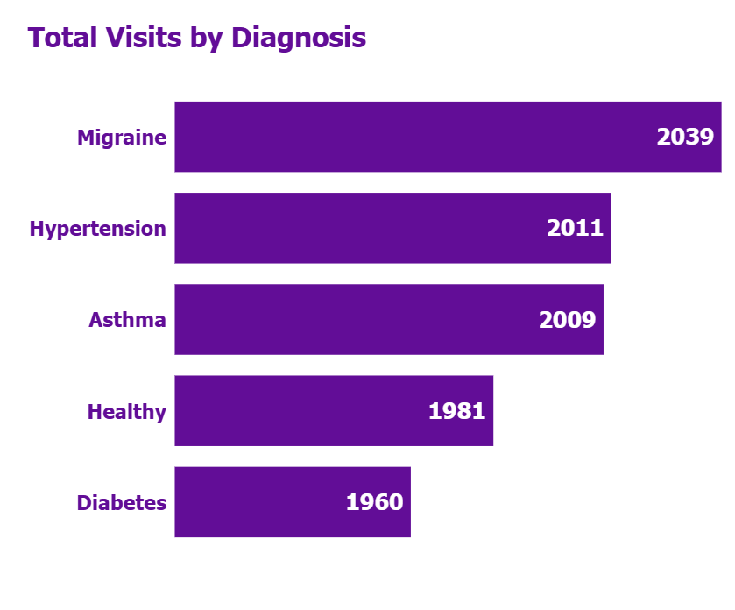
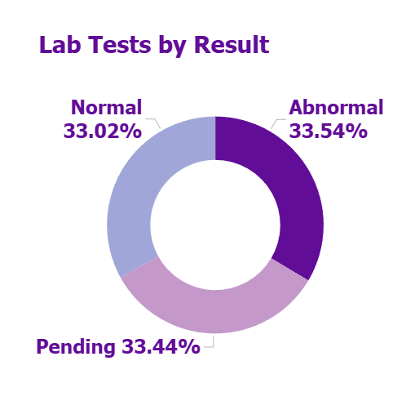
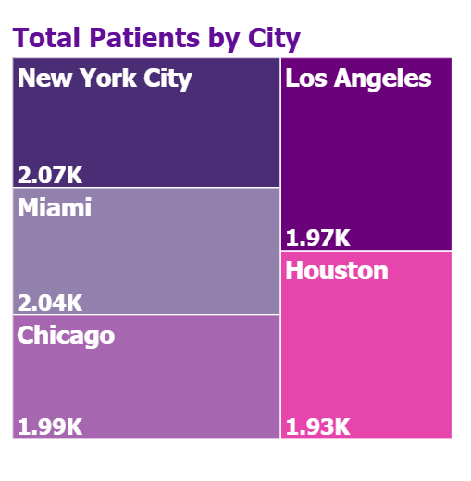
Patient & Clinical Insights
Lifestyle-related disease dominate. Hospital can focus on preventive care programs and specialty services.
High abnormal rate indicates strong demand for further treatment. Pending tests suggests scope to improve lab turnaround time
New York is the strongest market. Expansion strategies can focus on high-demand cities

Slide 8
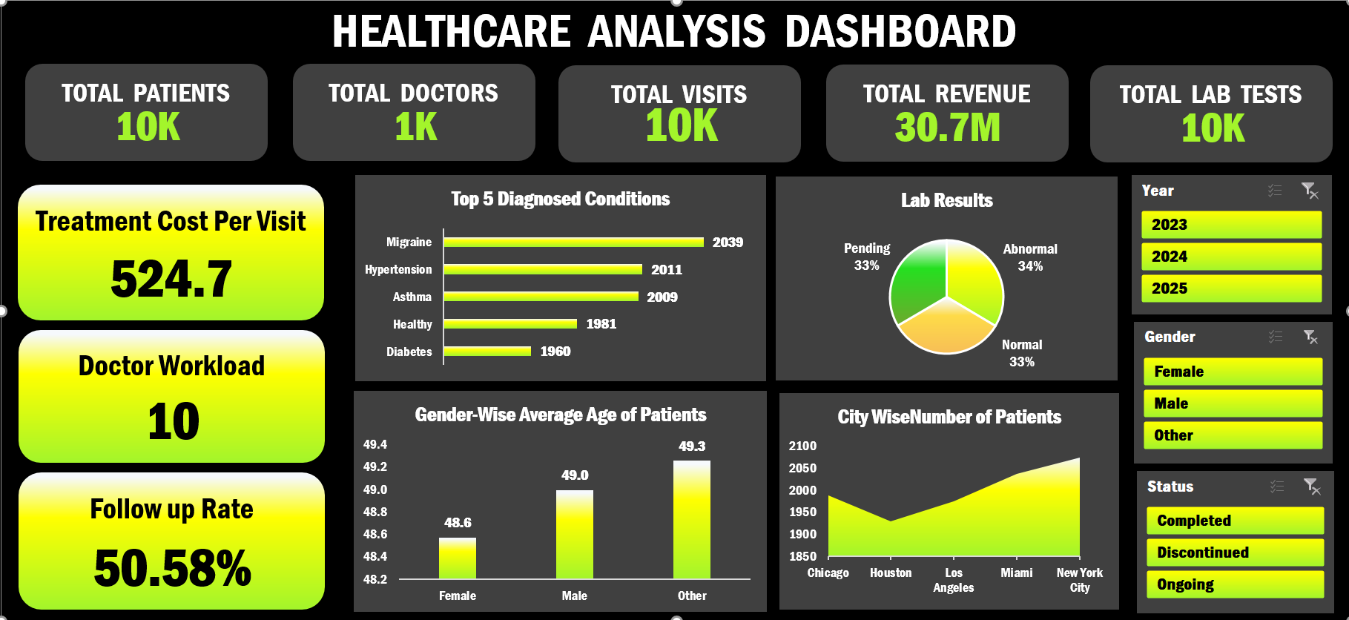
Excel Dashboard

Slide 9
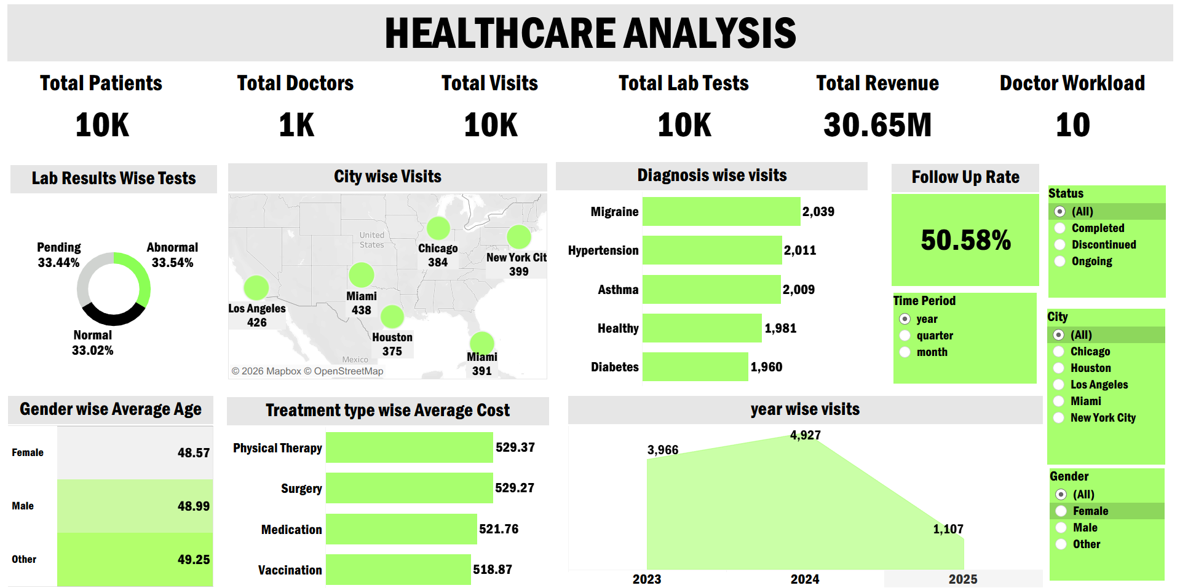
Tableau Dashboard

Slide 10
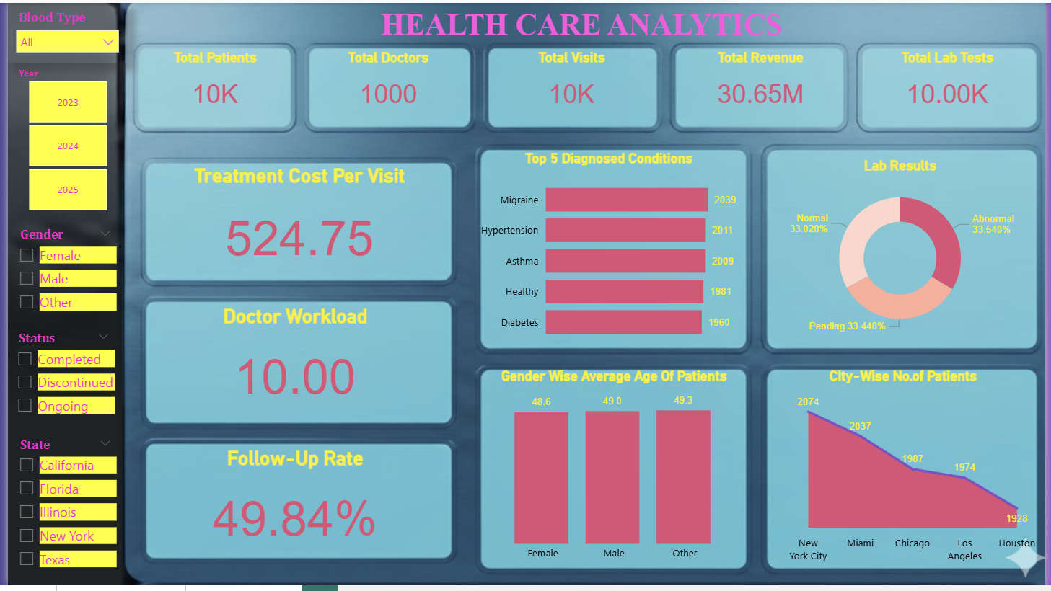
Power BI Dashboard

Slide 11
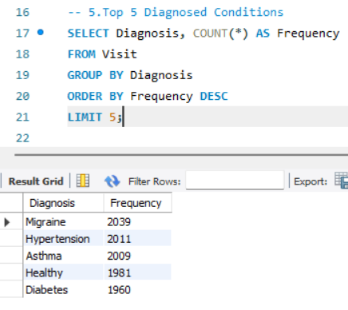
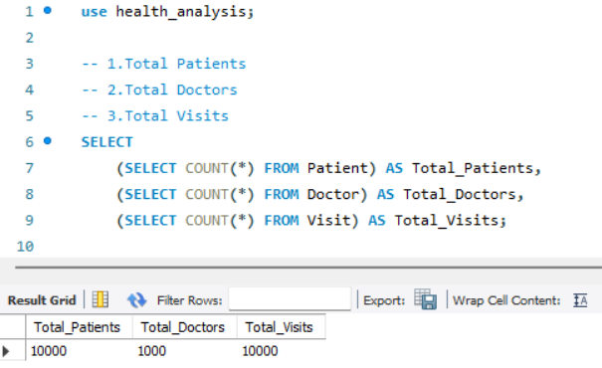
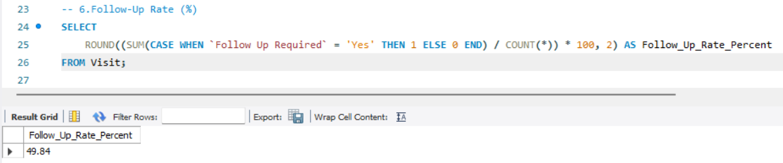
SQL Queries

Slide 12
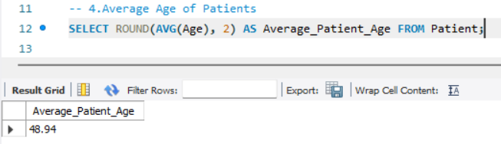
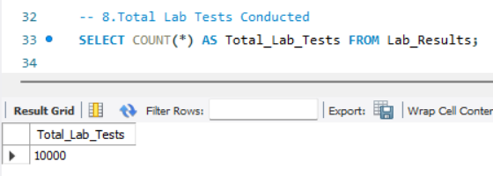
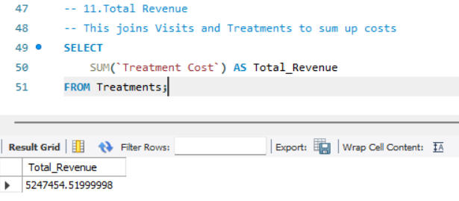

Slide 13
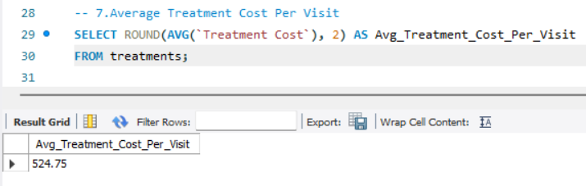
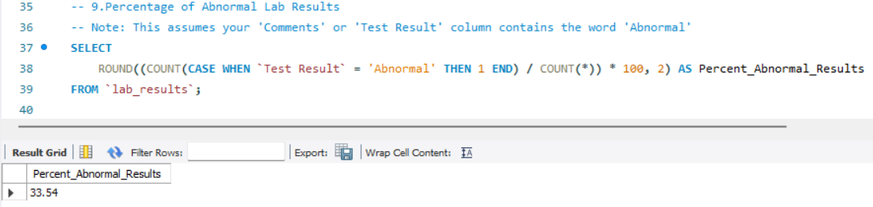
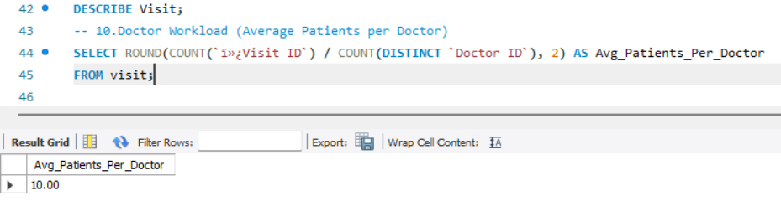

Slide 14


Improve follow-up rate through automated reminders to increase patient retention and recurring revenue.
Reduce pending lab tests to enhance operational efficiency and patient satisfaction.
Introduce preventive care programs for lifestyle diseases like hypertension and diabetes.
Plan additional resources for peak demand to avoid service delays,
Focus on high-performing cities to maximize revenue and strategic growth.
Suggestions

Slide 15
Conclusion
The healthcare analysis project demonstrates strong hospital performance with consistent patient volume and solid revenue growth. The dashboards highlight key trends in diagnoses, workload, and seasonal demand. By improving follow-up rates and operational efficiency, the hospital can enhance patient care, optimize resources, and increase overall profitability.

Slide 16
Thank You

